Slide 1
New Requisition Screen Changes
Procurement Services
For cyBUY and Non-catalog requisitions

Slide 2
Changes to Create Requisition Screen
Shipping address and Worktag fields have been moved to the first screen of the requisition process.
The Ship-To Address must be changed to one with a room or suite number along with the building and street address.
Guided Help Text is provided for some fields.
Fields that are not used by ISU have been removed.
A single checkout screen to streamline the checkout process.
Changes go into effect on Saturday, March 7th
Procurement Services

Slide 3
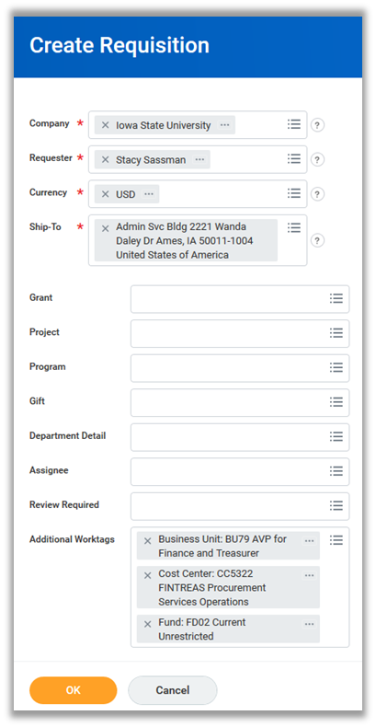
Current Screen New Screen
Procurement Services

Slide 4
New Guided Help Text
Procurement Services

Slide 5
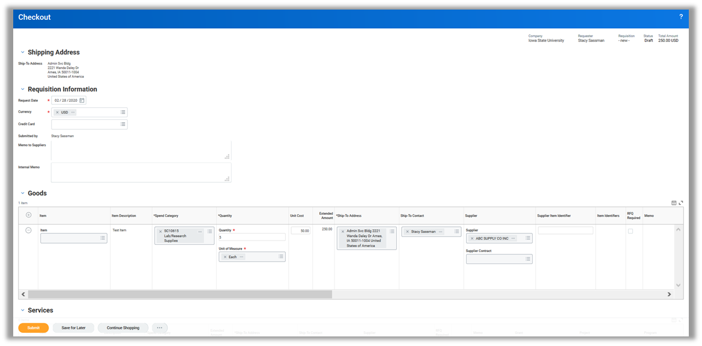
New Checkout Screen
Tabs have been removed to provide a single checkout page
Procurement Services

Slide 6
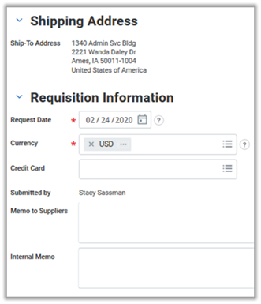
New Checkout Screen
The Memo to Suppliers field can be used to send notes to the supplier on a purchase order.
For cyBUY orders only the following suppliers accept notes: Airgas, ATCC, BioRad, Carolina Bio, Complete Book, DigiKey, Galls, Graybar, Henry Schein, Life Tech, Midwest Vet, MWI Vet, Qiagen, Sigma
The Internal Memo field is for the business purpose.
Procurement Services

Slide 7
New Checkout Screen
Under the three dots at the bottom of the screen:
Choose Edit Requisition Defaults if changes are needed to the Worktags (example: using multiple Worktags on an order)
Choose Edit Address if changes are needed to the Ship-To Address (if the ship-to was not changed on the first Create Requisition screen)
Procurement Services

